Slide 1
Group 11 - AntiPhishing Classifier
Kunal Kumar
Harshit Agrawal
Noopur R K
Richa Singh

Slide 2


DataSets
PhishStorm
https://research.aalto.fi/en/datasets/phishstorm--phishing--legitimate-url-dataset(f49465b2-c68a-4182-9171-075f0ed797d5).html
2. Phishtank
http://data.phishtank.com/data/online-valid.csv (Only fishing links, No Features)

Slide 3
Feature | Explanation
Length of the URL | Phishers can use long URL to hide the doubtful part in the address bar
Presence of IP address in the URL | If an IP address is used as an alternative of the domain name in the URL users can be sure that someone is trying to steal their personal information
Presence of dash in the URL | The dash symbol is rarely used in legitimate URLs. Phishers tend to add prefixes or suffixes separated by (-) to the domain name so that users feel that they are dealing with a legitimate webpage.
Number of Domain Name | Varying number of domains also is a sign of phishing website
Number of subdomains | If the dots are greater than two, it is classified as “Phishing” since it will have multiple sub domains.
Presence of @ | Using “@” symbol in the URL leads the browser to ignore everything preceding the “@” symbol and the real address often follows the “@” symbol.

Slide 4

Challenges with combining datasets
Data URL not consistent. Largest dataset doesn’t contain https:// => Loss of feature.
Different datasets have different features(# of days the link has been registered for, Page ranking).
Taking union of all the features with 0/mean/mode at missing data-points doesn’t necessarily increase the accuracy. Sometimes the accuracy drops.
Need universal way to generate missing features for all the different data-points. WhoIs API
WhoIs => ICANN Lookup
Need visualization to generate relevant features.

Slide 5
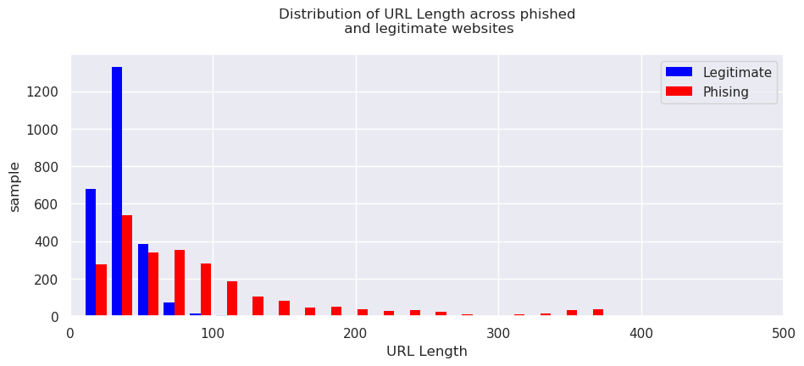
Data Visualization

Slide 6
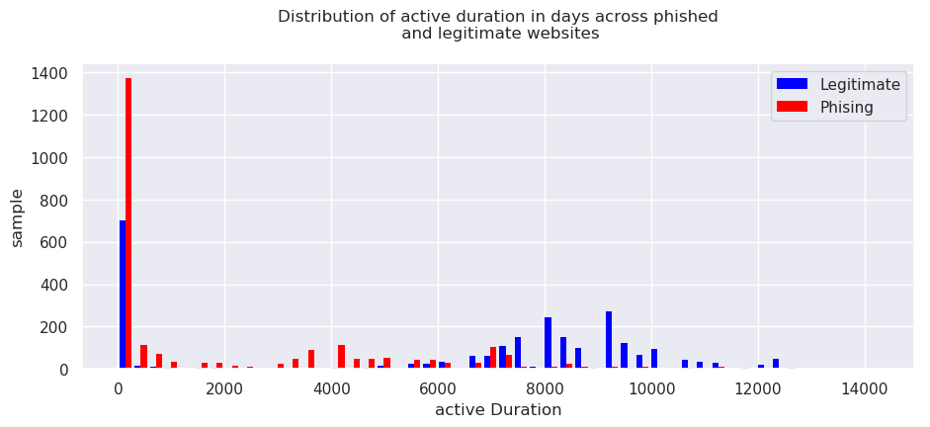
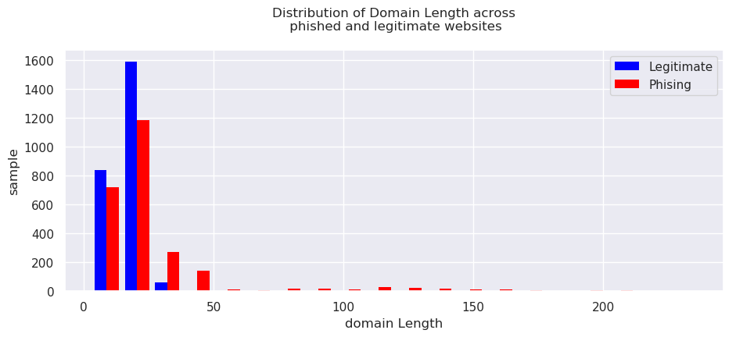
Data Visualization

Slide 7
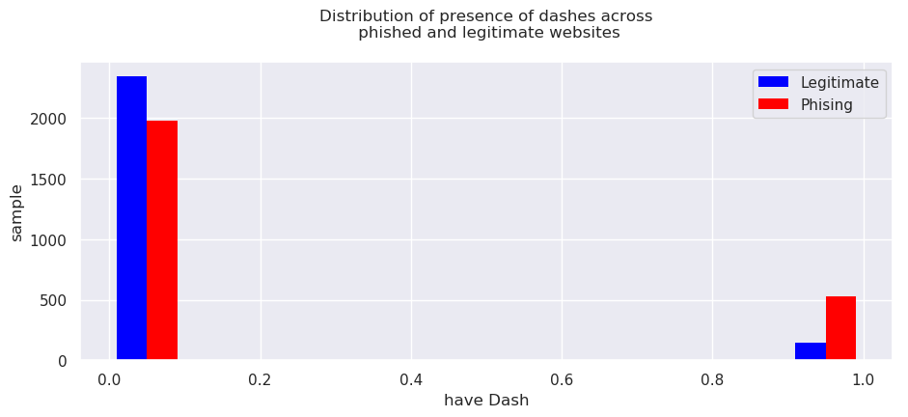
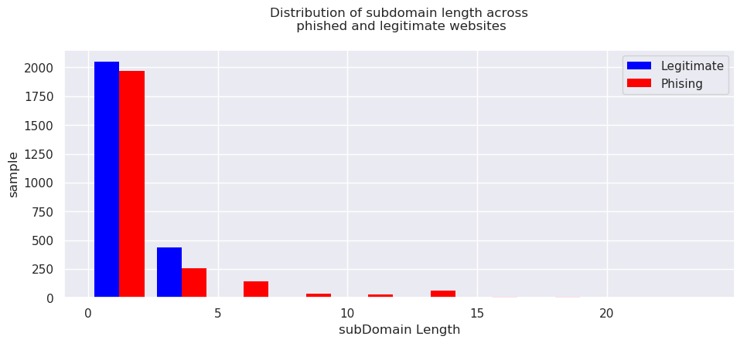
Data Visualization

Slide 8
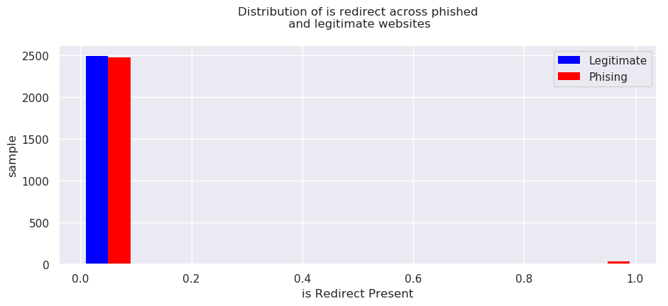
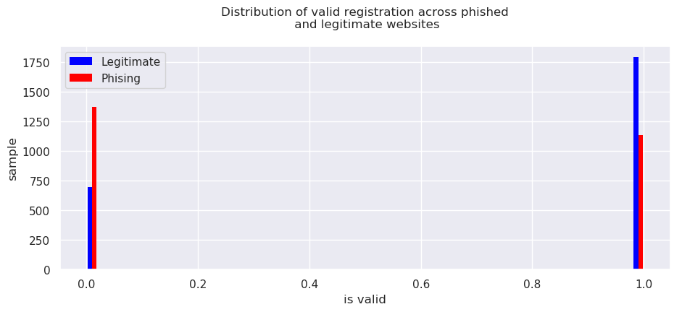
Data Visualization

Slide 9
Experiments
Cross Validation with a 80-20 split for training and testing data for a data of ~10000 datapoints.
Cross Validations using GridSearchCV for (5/10/20)-fold validations.
Experiments with different Parameter settings for different classifiers.
Hyperparameters tuning:
Logistic Regression : penalty=‘L1’ => Score: 0.85125
KNeighborsClassifier : metric= 'minkowski’, n_neighbors=96, weights='distance’ => Score: 0.89175
DecisionTreeClassifier : criterion='gini’ , min_samples_split=14 => Score: 0.88775
RandomForestClassifier : bootstrap=True, criterion='gini', max_depth = 13, n_estimators=70 Score=> 0.92

Slide 10
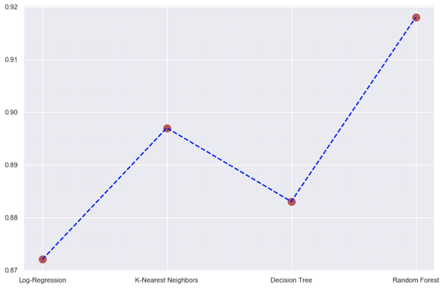
Models used for Classification
LogisticRegression : Accuracy = 87%
KNeighborsClassifier : Accuracy = 89%
DecisionTreeClassifier : Accuracy = 88%
RandomForestClassifier : Accuracy = 92%

Slide 11
Thankyou

